Slide 1
Chapter 8 More on Strings and Special Methods

Slide 2
Objectives
To learn how to create strings (§8.2.1).
To use the len, min, and max functions to obtain the length of a string or the smallest or largest element in a string (§8.2.2).
To access string elements by using the index operator ([])(§8.2.3).
To use the in and not in operators to determine whether a string is contained within another string (§8.2.6).
To compare strings by using comparison operators (==, !=, <, <=, >, and >=) (§8.2.7).
To iterate characters in a string by using a foreach loop (§8.2.8).
To test strings by using the methods isalnum, isalpha, isdigit, isidentifier, islower, isupper, and isspace (§8.2.9).
To search for substrings by using the methods endswith, startswith, find, rfind, and count (§8.2.10).
To convert strings by using the methods capitalize, lower, upper, title, swapcase, and replace (§8.2.11).

Slide 3
The str Class
Creating Strings
  s1 = str() # Create an empty string
  s2 = str("Welcome") # Create a string Welcome
Python provides a simple syntax for creating string using a string literal. For example,
  s1 = "" # Same as s1 = str()
  s2 = "Welcome" # Same as s2 = str("Welcome")

Slide 4
Functions for str
>>> s = "Welcome"
>>> len(s)
7
>>> max(s)
o
>>> min(s)
W

Slide 5
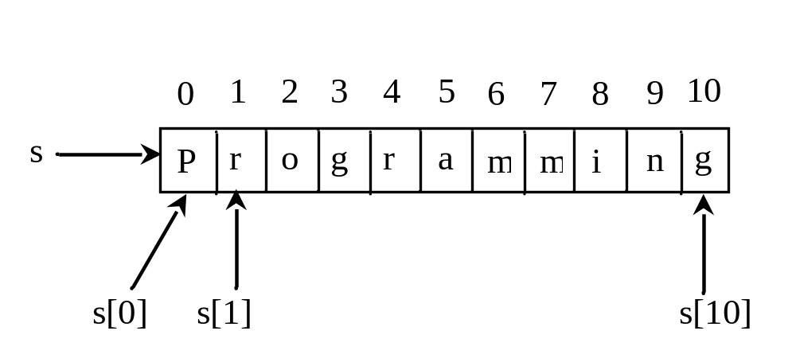
Index Operator []

Slide 6
The +, *, [ : ], and in Operators
>>> s1 = "Welcome"
>>> s2 = "Python"
>>> s3 = s1 + " to " + s2
>>> s3
’Welcome to Python’
>>> s4 = 2 * s1
>>> s4
’WelcomeWelcome’
>>> s1[3 : 6]
’com’
>>> 'W' in s1
True
>>> 'X' in s1
False

Slide 7
The in and not in Operators
>>> s1 = "Welcome"
>>> "come" in s1
True
>>> "come" not in s1
False
>>>

Slide 8
Foreach Loops
for ch in string:
print(ch)
for i in range(0, len(s), 1):
print(s[i])

Slide 9
Comparing Strings
>>> s1 = "green"
>>> s2 = "glow"
>>> s1 == s2
False
>>> s1 != s2
True
>>> s1 > s2
True
>>> s1 >= s2
True
>>> s1 < s2
False
>>> s1 <= s2
False

Slide 10
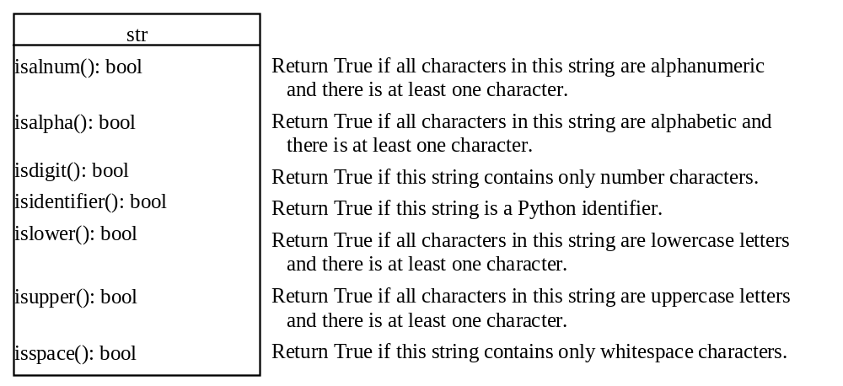
Testing Characters in a String

Slide 11
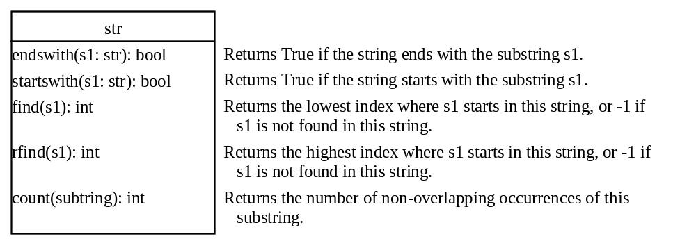
Searching for Substrings

Slide 12
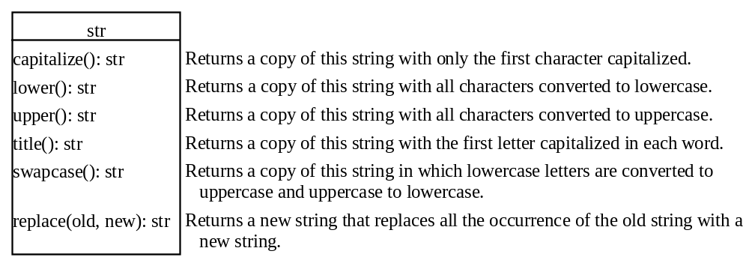
Converting Strings

Slide 13
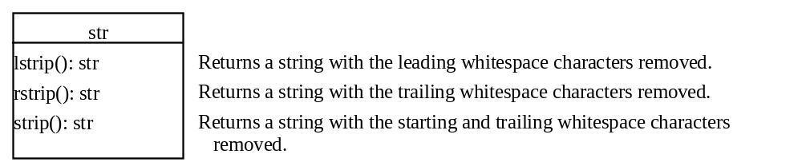
Stripping Whitespace Characters

Slide 14
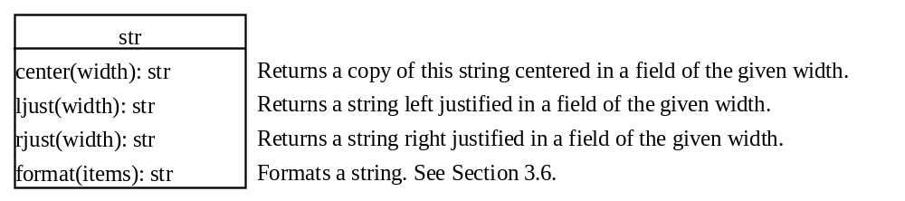
Formatting Strings

Slide 15
Problem: Finding Palindromes
Objective: Checking whether a string is a palindrome: a string that reads the same forward and backward.
CheckPalindrome
Run

